Slide 1
Presentation on Machine Learning
Prepared Under the Guidance of
Dr. Ramesh Kait Sir
Submitted To: Submitted By: Dr. Ramesh Kait Sir Hitesh
Roll No 8100360
MCA 4th Sem
Section B
Department of Computer Science and Applications
Kurukshetra University, Kurukshetra

Slide 2
Introduction to Machine Learning
Machine learning is a branch of artificial intelligence (AI) focused on building applications that learn from data and improve their accuracy over time without being programmed to do so.
In machine learning, algorithms are 'trained' to find patterns and features in massive amounts of data in order to make decisions and predictions based on new data. The better the algorithm, the more accurate the decisions and predictions will become as it processes more data.

Slide 3
Evolution of Machine Learning
1950 – Alan Turing invented the Turing Test, to determine if a computer can pass for a human-based on its written linguistic fluency.
1979 – Stanford students built the Stanford Cart, a remotely-controlled, autonomous cart that could navigate on its own and avoid bumping into objects. It was designed to help study the remote control of a Moon rover.
1997 – IBM’s supercomputer beat Garry Kasparov in chess..
2014 – Facebook created DeepFace, a facial recognition system capable of detecting faces in images, and accurately identifying humans.
2017 – Google developed an algorithm that can detect diseases, such as cancer, with 89% accuracy.

Slide 4
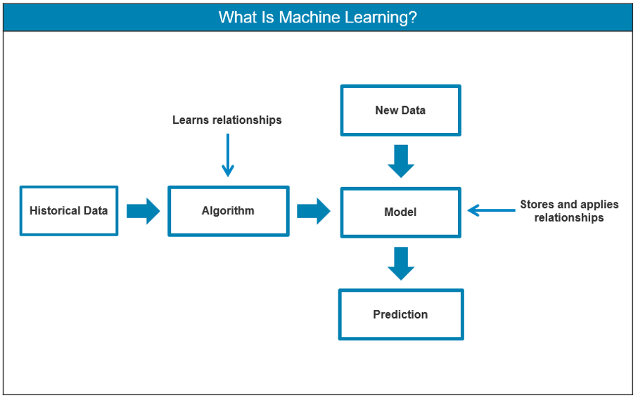
Machine Learning Model
Step 1: Select and prepare a training data set
Step 2: Choose an algorithm to run on the training data set
Step 3: Training the algorithm to create the model
Step 4: Using and improving the model

Slide 5
Supervised Learning
Supervised algorithms refer to learning guided by human observations and feedback with known outcomes.
For instance, suppose we want the machine to separate email into spam and non-spam messages.
In a supervised learning environment, we already have information that we can feed the machine to describe what type of email should belong to which category.
The machine therefore knows that there are two labels available in which to sort the incoming data (emails).

Slide 6
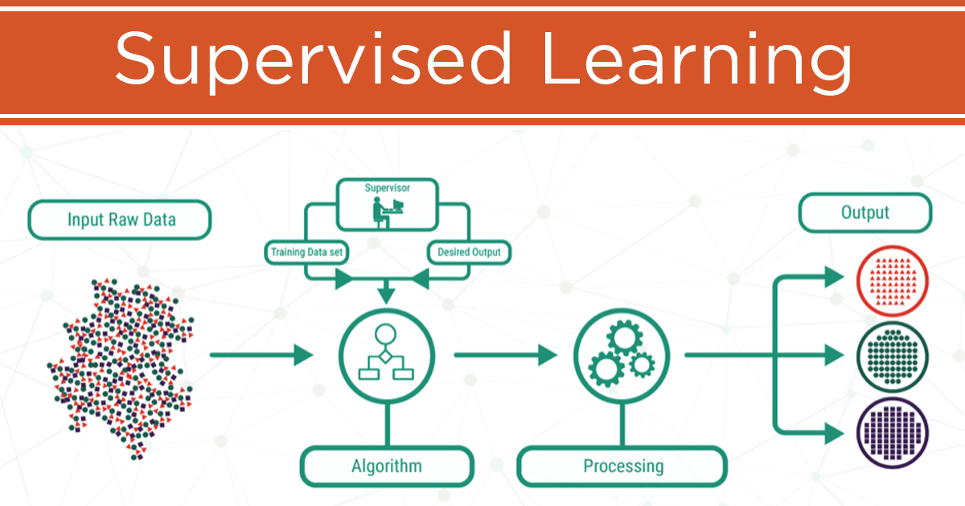
Supervised learning works by feeding the machine sample data with various features (represented as “X”) and the correct value output of the data (represented as “y”). The fact that the output and feature values are known qualifies the dataset as “labeled.” The algorithm then deciphers patterns that exist in the data and creates a model that can reproduce the same underlying rules with new data.

Slide 7
Unsupervised Learning
In case of an unsupervised learning environment, there is no such integrated feedback or use of tags. Instead the machine learning algorithm must rely exclusively on clustering separate data and modify its algorithm to respond to its initial findings - all without the external feedback of humans.
For example, if you cluster data points based on the weight and height of 13-year old high school students, you are likely to find that two clusters will emerge from the data. One large cluster will be male and the other large cluster will be female. This is because girls and boys tend to have separate commonalities in regards to physical measurement.

Slide 8
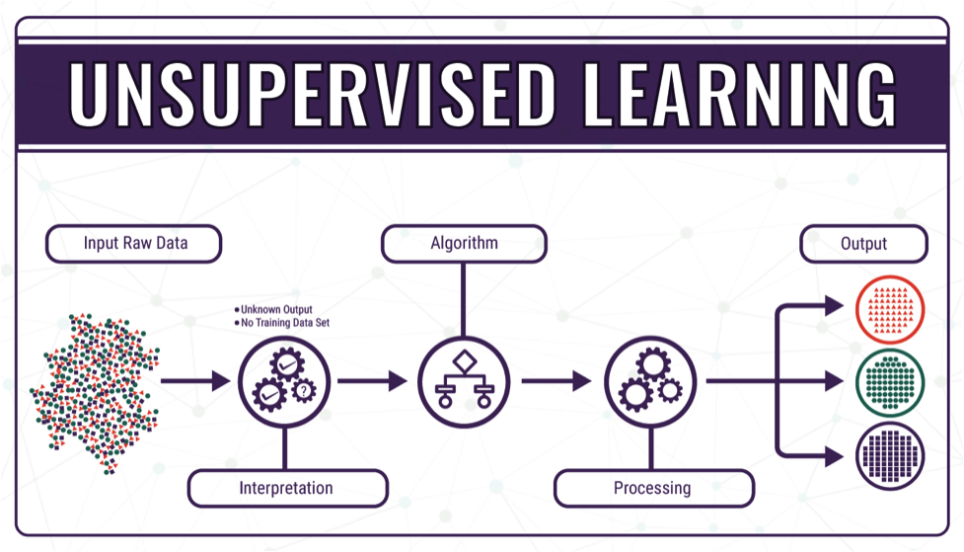
A clustering algorithm computes the distance between groupings and divides data points into multiple groups based on their relational distance to one another.
Clustering can be applied to uncover customers that share similar purchasing behaviour. By understanding a particular cluster of customer purchasing preferences you can then form decisions on which products you can recommend to the group based on their commonalities. You can do this by offering them the same promotions via email or click ad banners on your website.

Slide 9
Reinforcement Learning
Reinforcement machine learning is a behavioral machine learning model that is similar to supervised learning, but the algorithm isn’t trained using sample data.
This model learns as it goes by using trial and error.
A sequence of successful outcomes will be reinforced to develop the best recommendation or policy for a given problem.

Slide 10
Reinforcement Learning Cont.
A standard reinforcement learning model has measurable performance criteria where outputs are not tagged—instead, they are graded.
A specific algorithmic example of reinforcement learning is Q-learning. In Q learning, you start with a set environment of states, represented by the symbol ‘S’.
Q drops as negative things occur after a given state/action
Q increases as positive things occur after a given state/action

Slide 11
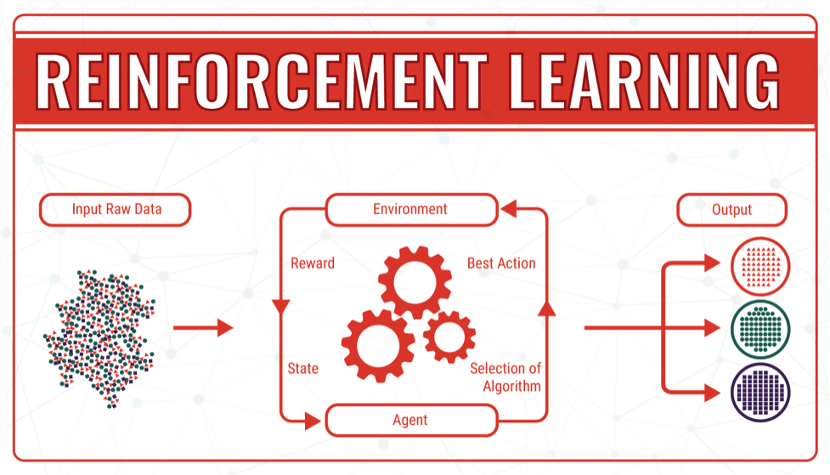
In the case of self-driving vehicles, avoiding a crash will allocate a positive score.
Some of the autonomous driving tasks where reinforcement learning could be applied include trajectory optimization, motion planning, dynamic pathing, controller optimization, and scenario-based learning policies for highways.

Slide 12
Career Paths in Machine Learning
Machine Learning Engineer- A ML engineer is an engineer that runs various machine learning experiments using programming languages such as Python, Java, Scala etc. with the appropriate machine learning libraries.
NLP Scientist-NLP Scientist basically helps in the creation of a machine that can learn patterns of speech and also translate spoken words into other languages.
Data Scientist- A data scientist uses advanced analytics technologies, including Predictive Modeling to collect, analyze and interpret large amounts of data and produce actionable insights.

Slide 13
Conclusion
Machine learning is the extraordinary achievement in the field of Artificial Intelligence.
It is an exciting time for the field, as connections to many other areas are being discovered and explored, and as new machine learning applications bring new questions to be modeled and studied. It is safe to say that the potential of Machine Learning and its theory lie beyond the frontiers of our imagination.

Slide 14
THANK YOU

